Slide 1
Parallel Computer Structures

Slide 2
Parallel computers are those systems that emphasize parallel processing.
Parallel computers are divided into three architectural configurations:
  Pipeline computers
  Array processors
  Multiprocessors

Slide 3
  A pipeline computer performs overlapped computations to exploit temporal parallelism.
  An array processor uses multiple synchronized arithmetic logic units to achieve spatial parallelism
  A multiprocessor system achieves asynchronous parallelism through a set of interactive processors with shared resources.
  The diff. bet an array processor and a multiprocessor is that the processing elements in an array processor operate synchronously but processors in multiprocessor system may operate asynchronously.

Slide 4
Pipeline computer
The process of executing an instruction involves 4 major steps:
In a non pipelined computer, these 4 steps must be completed before the next instruction can be issued.
In a pipelined computer, successive instructions are executed in an overlapped fashion.
S1 S2 S3 S4 ( stages)
IF
ID
OF
EX
Pipelined processor

Slide 5
Operation of all stages is synchronized under a common clk control.
Interface latches are used between adjacent segments to hold the intermediate results
For the nonpipelined computer,it takes 4 pipeline cycles to complete one instruction.
Once a pipeline is filled up,an o/p result is produced from the pipeline on each cycle.

Slide 6
a) Pipelined stages O/P
EX
OF
ID
IF
I1 I2 I3 I4 I5
I1 I2 I3 I4 I5
I1 I2 I3 I4 I5
I1 I2 I3 I4 I5
1 2 3 4 5 6 7 8 9
b) NonPipelined stages
O/P
O/P
O/P
EX
OF
ID
IF
I1 I2 I3
I1 I2 I3
I1 I2 I3
I1 I2 I3 I4
1 2 3 4 5 6 7 8 9 10 11 12 13

Slide 7
Performance Comparison
To complete n tasks with clock time tp using a k-segment pipeline requires k+(n-1) clock cycles.
For e.g. consider 4 segments and 5 tasks. The time required to complete all the operations is 4 + (5-1) = 8 clock cycles.
Consider a non-pipeline unit that performs the same operation and takes a time tn to complete each task. The total time required for n tasks is n*t.

Slide 8
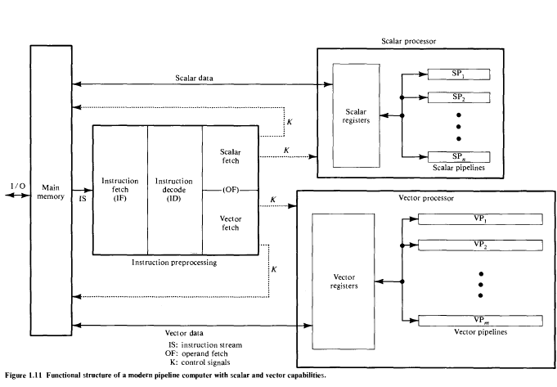

Slide 9
Array Processors
Array processor is a synchronous parallel computer with multiple ALUs, called processing elements (PE), that can operate in a lock step fashion.
The PEs are synchronized to perform the same function at the same time.
Scalar and control type instructions are directly executed in the control unit (CU).
Each PE consists of an ALU with registers and a local memory.

Slide 10
SIMD Array Processor
A SIMD array processor is a computer with multiple processing units operating in parallel.
The PUs are synchronized to perform the same operation under the control of a common CU, thus providing a single instruction stream, multiple data stream (SIMD) organization.
It contains a set of PEs each having a local memory M. Each PE includes an ALU, a floating point arithmetic unit, and working registers.
The main memory is used for storage of the program.
The CU controls the operations in the PEs. It decodes the instructions and determine how the instruction is to be executed.
Vector instructions are broadcast to all PEs simultaneously. Each PE uses operands stored in its local memory. Vector operands are distributed to the local memories prior to the parallel execution of the instruction.

Slide 11
PE1
M1
Master control Unit
PE2
M2
PE3
M3
. . .
. . .
PE_{n}
M_{n}
Main Memory

Slide 12
The best known SIMD array processor is the ILLIAC IV computer.
SIMD processors are highly specialized computers which are suited primarily for numerical problems that can be expressed in vector or matrix form.

Slide 13
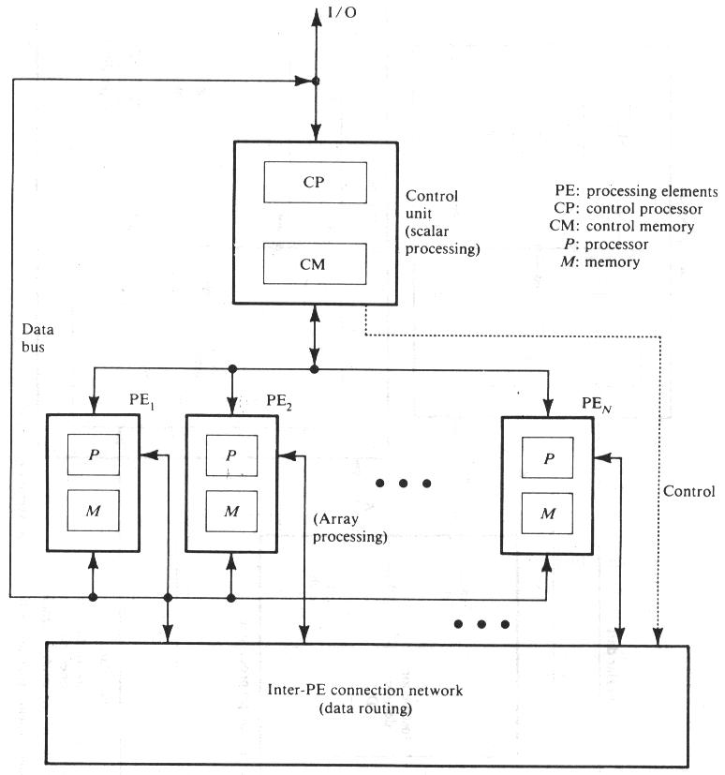
Functional Structure of SIMD array processor with concurrent processing in the control unit

Slide 14
The PEs is interconnected by a data routing network.
Vector instructions are broadcasted to the PEs for distributed execution over different component operands fetched directly from local memories.

Slide 15
Multiprocessor systems
The system contains two or more processors of appropriately comparable capabilities.
All processors share access to common sets of memory modules, I/O channels ,and peripheral devices.
The entire system must be controlled by a single integrated OS providing interactions between processors and their programs.
Each processor has its own local memory and I/O devices.
A multiprocessor system is an interconnection of 2 or more CPUs with memory and input-output devices.
Interprocessor communications can be done through the shared memories or through an interrupt network.
Multiprocessors are MIMD systems.

Slide 16
If a fault causes one processor to fail, a second processor can be assigned to perform the functions of the disabled processor.
The system as a whole can continue to function correctly with perhaps some loss in efficiency.
The adv from a multiprocessor organization is an improved system performance and reliability

Slide 17
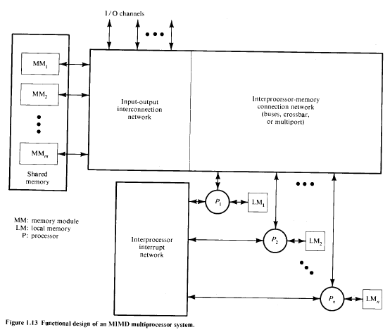

Slide 18
Architectural Aspects
The architecture of multiprocessor system contains a number of CPU’s and a number of Input Output Processors with so many i/o devices and a memory unit connected and it needs a no. of network policies to be considered to get the maximum performance with minimized complexity.
Three different interconnections :
    Time-shared common bus
    Crossbar switch network
    Multiport memories.

Slide 19
Time-shared common bus
A common bus multiprocessor system consists of a number of processors connected through a common path to a memory unit.
In a time shared common bus, only one processor can communicate with the memory or another processor at any given time.
Memory Unit
IOP 1
IOP 1
Common Bus
CPU 1
CPU 1
CPU 1

Slide 20
Crossbar Switch Organization
The organization consists of a number of crosspoints that are placed at intersections between processor buses and memory module paths.
The small square in each crosspoint is a switch that determines the path from a processor to a memory module
Each switch point has control logic to set up the transfer path between a processor and memory.

Slide 21
MM 1
MM 2
MM 3
CPU 1
CPU 2
CPU 3
Crossbar Switch

Slide 22
Multiport Memory
A multiport memory system employs separate buses between each memory module and each CPU.
MM 1
MM 2
MM 3
MM 4
CPU 1
CPU 1
CPU 2
CPU 3
CPU 4

Slide 23
Each processor bus is connected to each MM.
A processor bus consists of address, data and control lines required to communicate with memory.
The MM is said to have 4 ports and each port accommodates one of the buses.
The module must have internal control logic to determine which port will have access to memory at any given time.

Slide 24
The advantage is the high transfer rate that can be achieved because of the multiple paths between processors and memory.

